Slide 1
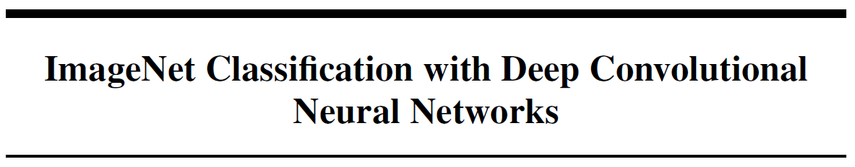

Slide 2


The neural network, which has 60 million parameters and 650,000 neurons, consists of five convolutional layers, some of which are followed by max-pooling layers, and three fully-connected layers with a final 1000-way softmax.
To make training faster, we used non-saturating neurons and a very efficient GPU implementation of the convolution operation.
To reduce overfitting in the fully-connected layers we employed a recently-developed regularization method called “dropout” that proved to be very effective.
Configuration
methodology
the immense complexity of the object recognition task means that this problem cannot be specified even by a dataset as large as ImageNet, so our model should also have lots of prior knowledge to compensate for all the data we don’t have.
CNNs can be controlled by changing the depth and width of the neural network.
CNNs have significantly fewer connections and parameters compared to standard Feedforward neural networks.
Training is easier.
Advantages
CNN
Convolutional neural networks (CNNs)
Disadvantages
CNN is expensive to learn high-resolution images.

Slide 3
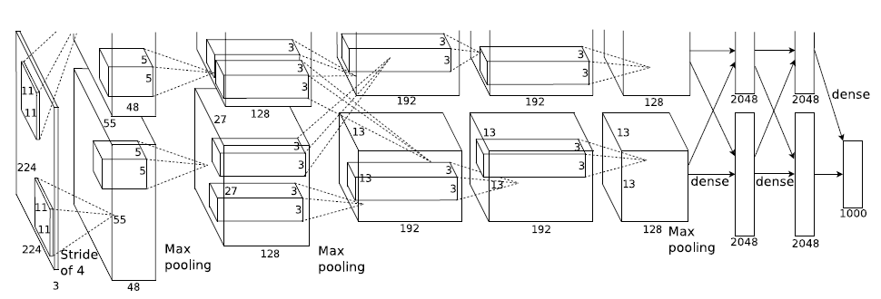
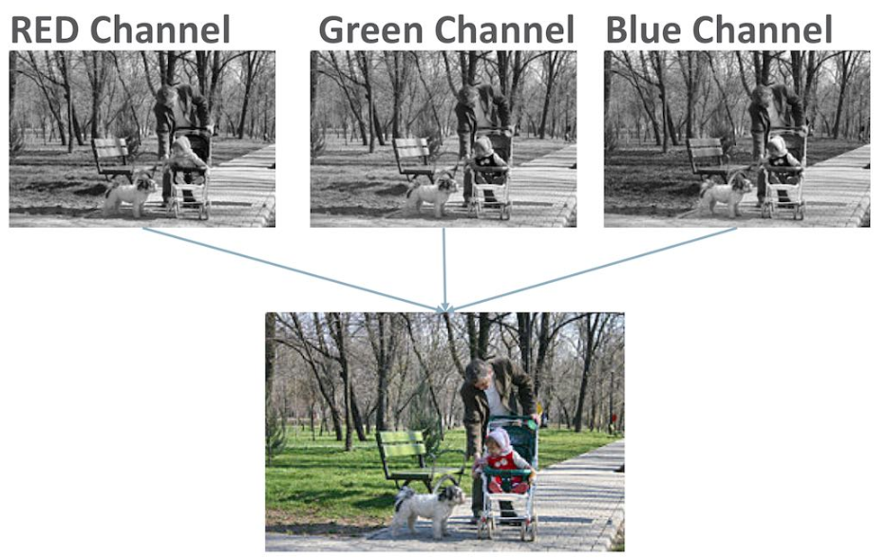
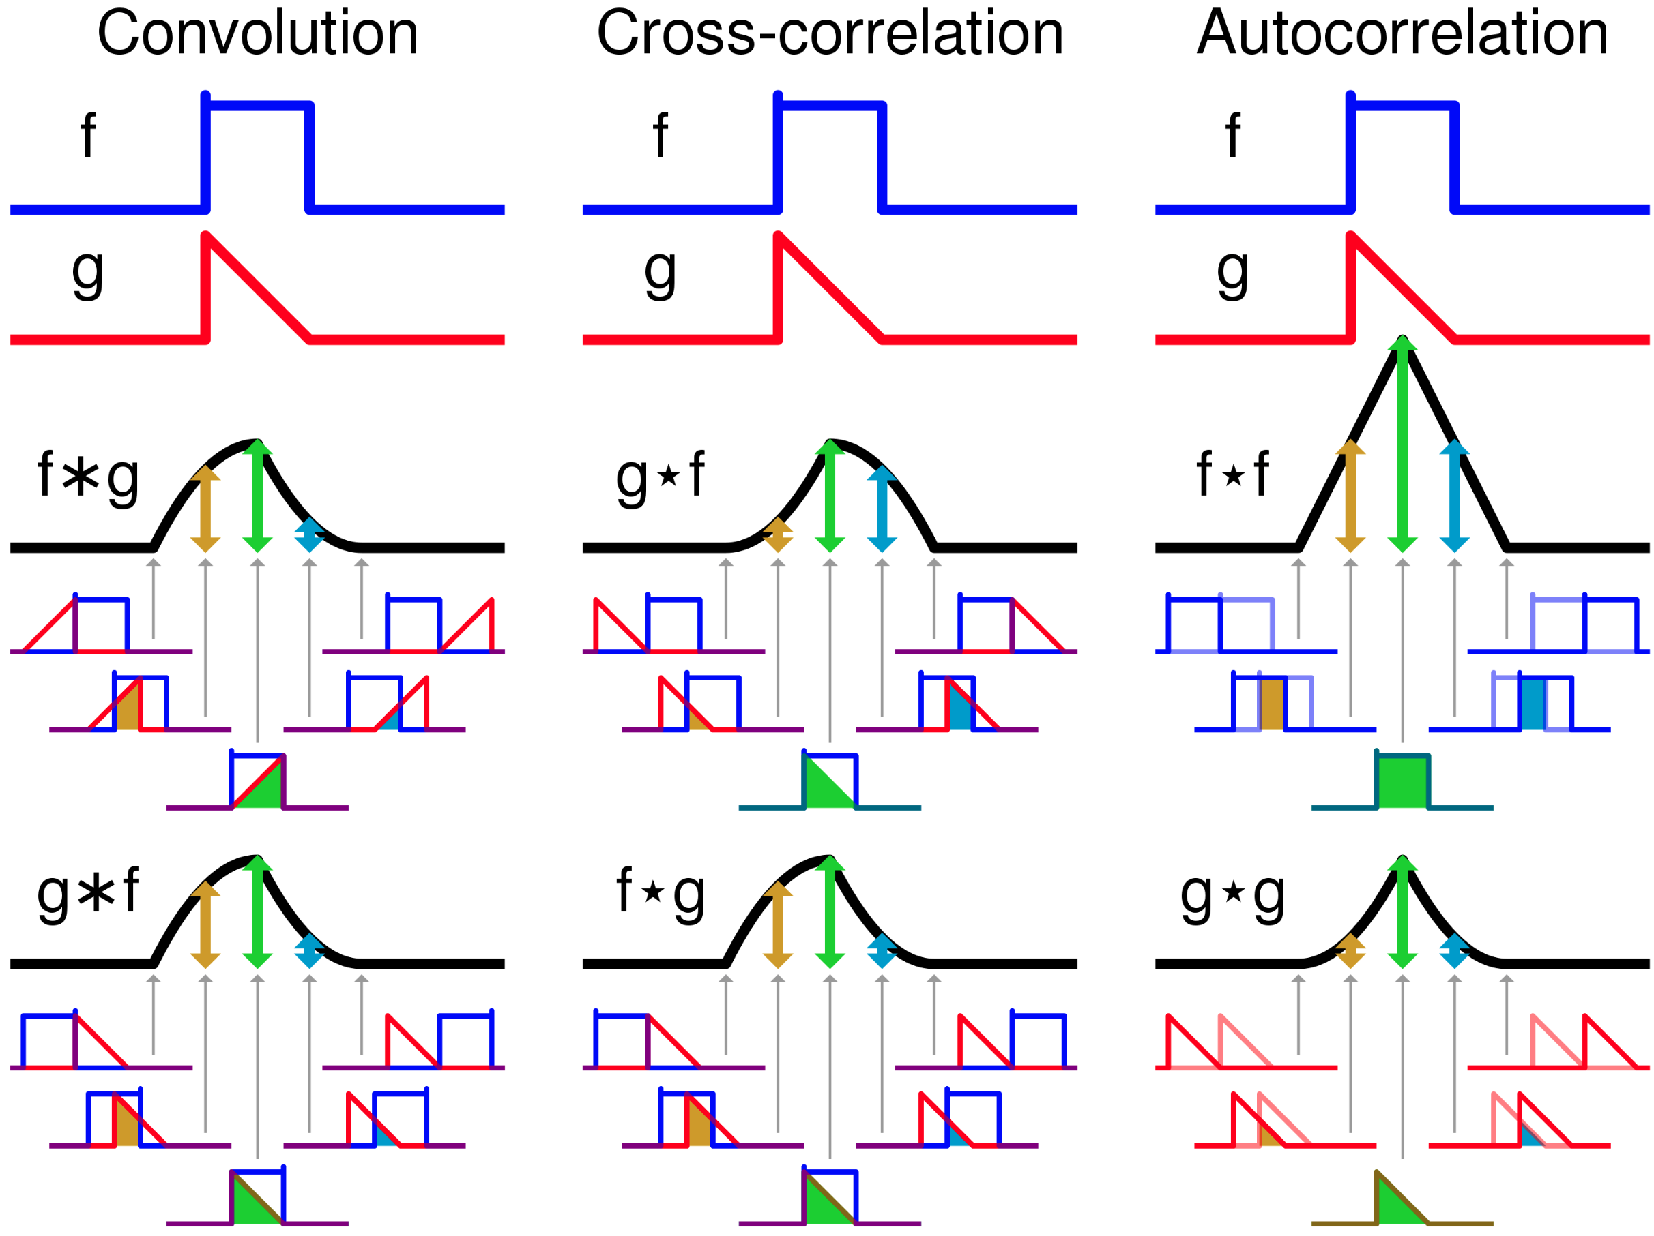
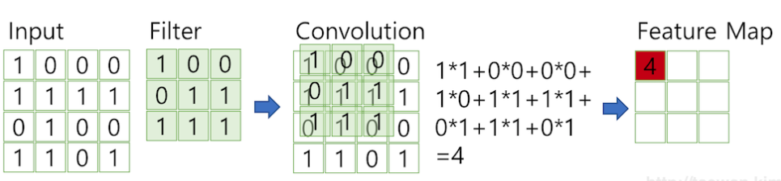
CNN
Channel
Channel of color pictures : 3
Channel of Black and white pictures : 1
Convolution
Filter(Kernel)

Slide 4
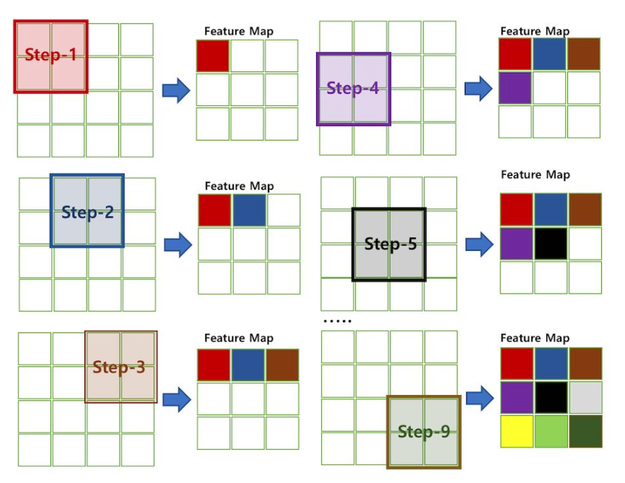
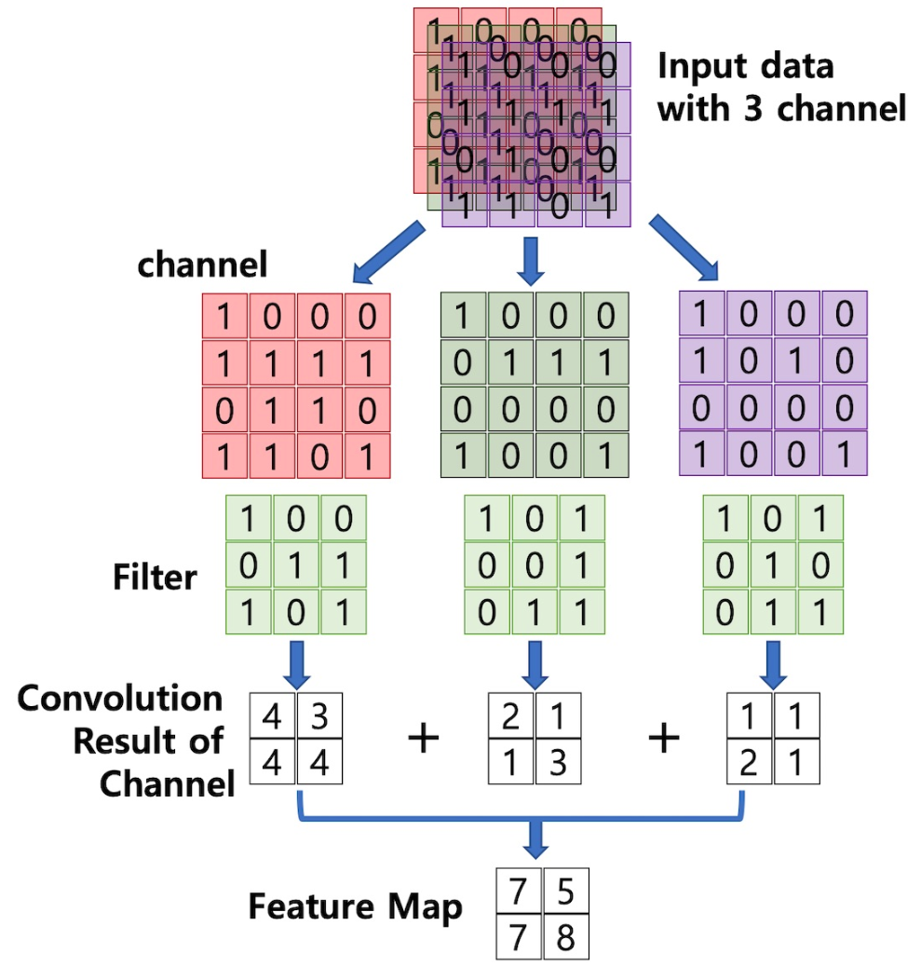
Stride
Feature Map or Activation Map

Slide 5
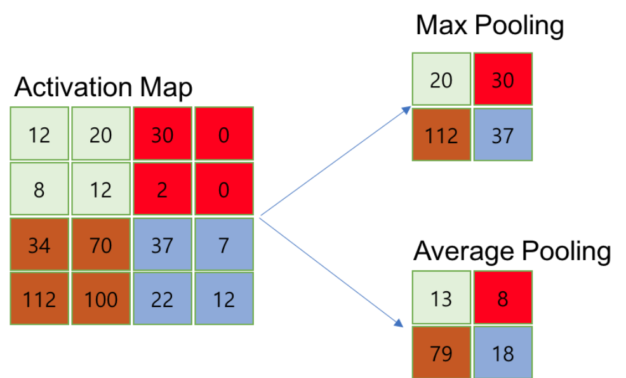
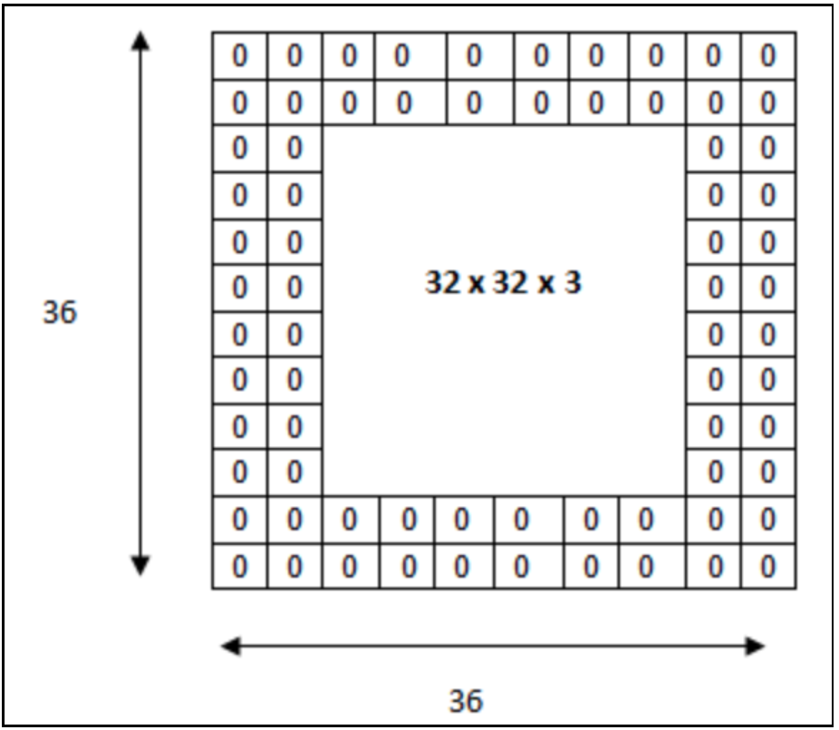
Pooling Layer
In this paper, Max Polling is used.
In general, set the Pooing size and Stride to the same size so that all elements are processed once.
Padding
It prevents the feature from being lost by preventing the resulting value from getting smaller.
It dilutes the original features to prevent overfitting.

Slide 6

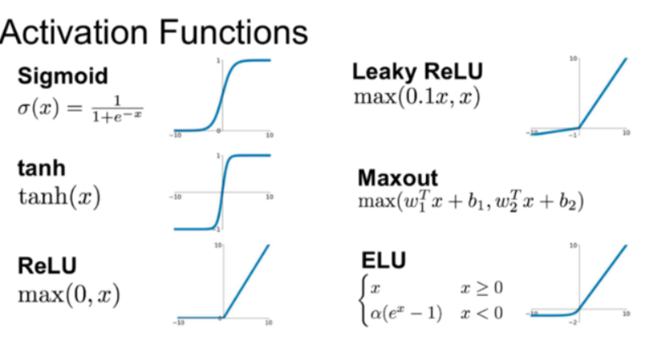
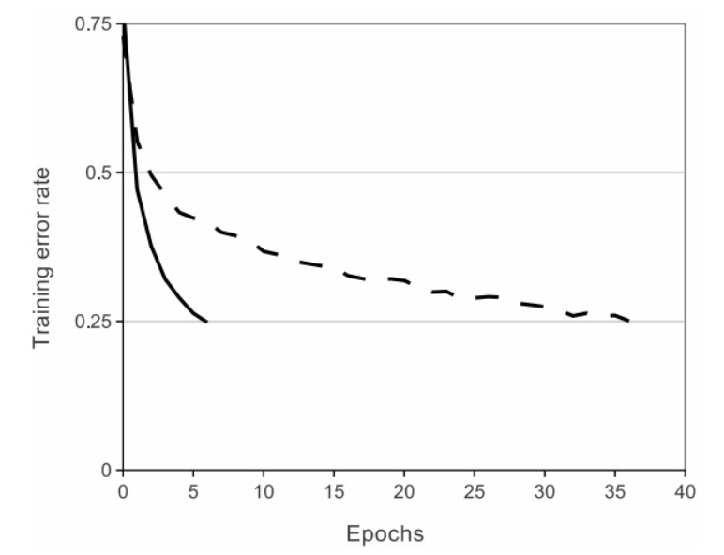
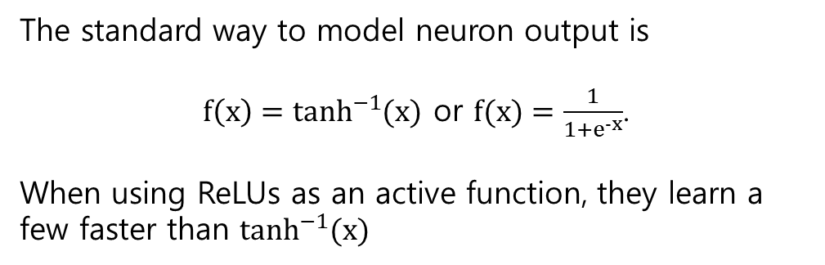
The standard way to model neuron output is
${f\left(x\right)=tanh}^{−1}{(x)}$ or $f(x)=\frac{1}{1+e^{-x}}$.
When using ReLUs as an active function, they learn a few faster than $\tanh^{−1}{(x)}$

Slide 7

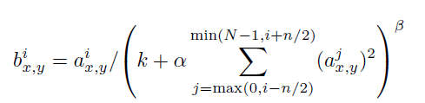
In paper
we still find that the following local normalization scheme aids generalization.
Why?

Slide 8
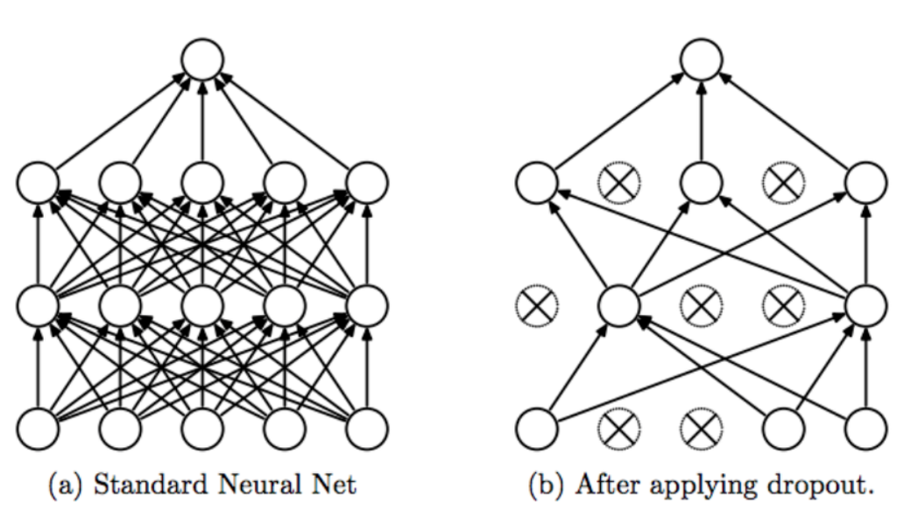
Dropout
When training, randomly “drop out (exclude)” neurons
Performance is improved because many models are created, trained, and predictions are executed within them.
There is a possibility that overfitting may occur when learning with one model, but if you make predictions with multiple models, you can get the so-called 'collective intelligence' and reduce the risk of overfitting.
The neural network model that drops out is a single, but generating the multiple models to execute the training is called “ensemble learning”.

